Slide 1
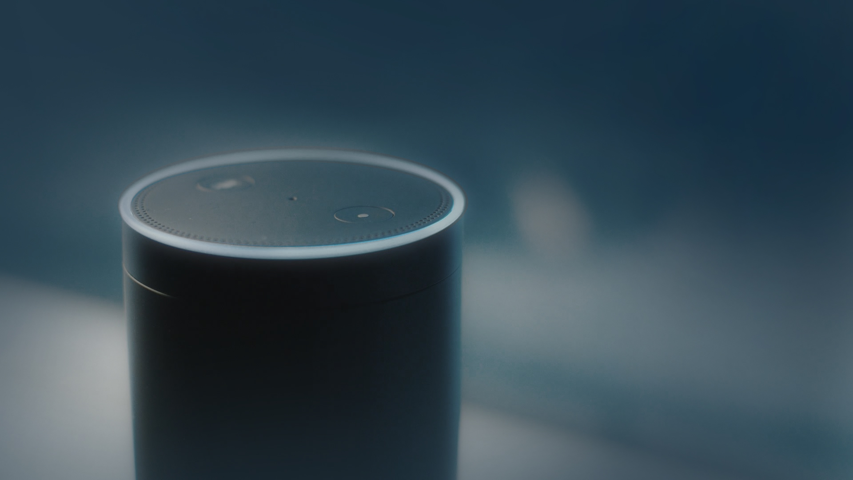

Welcome to Med Assist
Hello
voice assistant

Slide 2
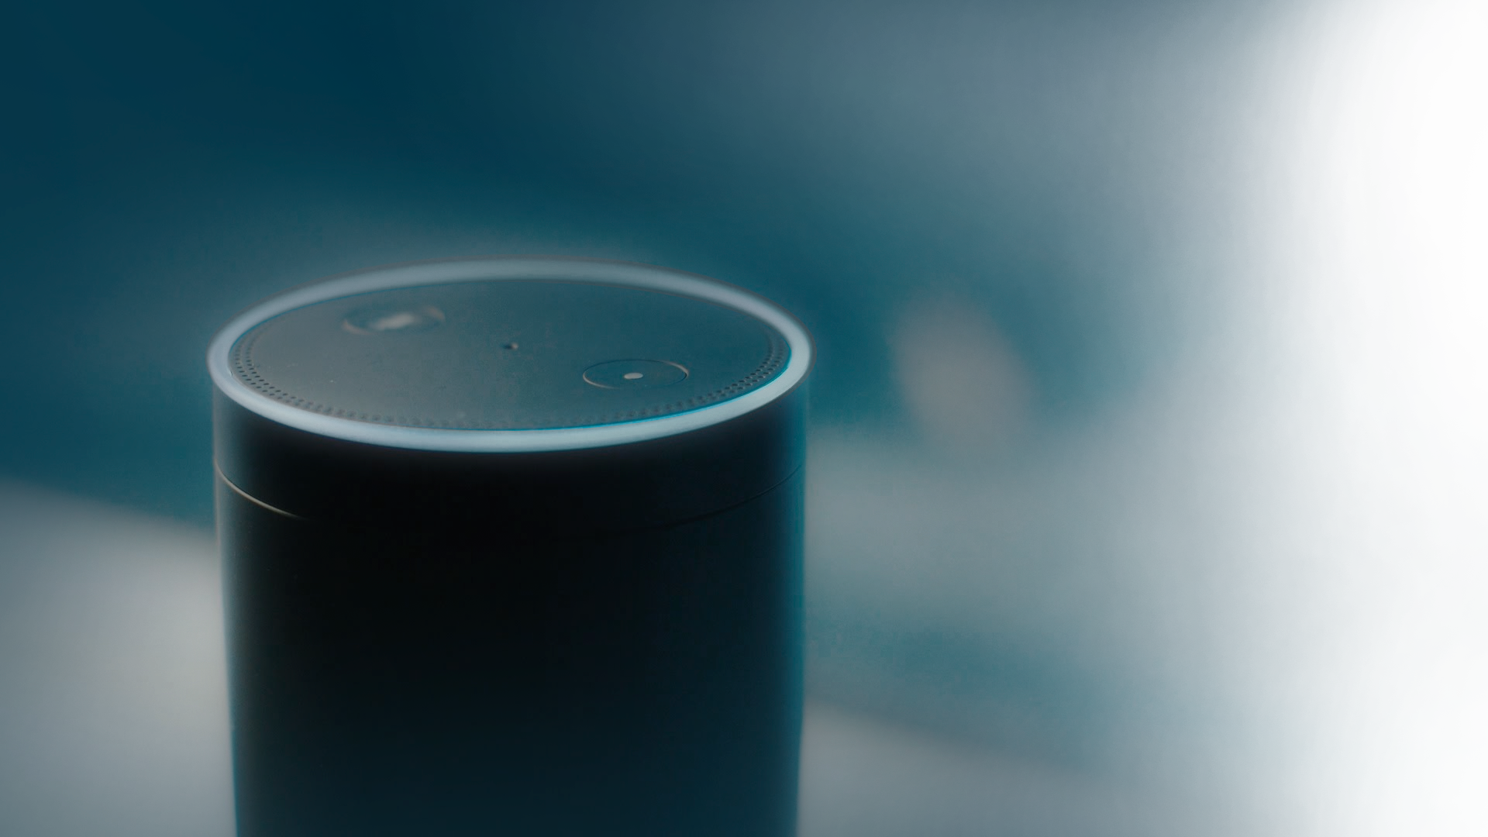
Ok, I will tell your appointments.
What's on today
Could you please tell your identification number(4 digit)?

Slide 3
Hello Doctor, 1. (3000) [ear] Doctor appointment done via Alexa for ear specialist at Kochi, Kerala, India on Fri Jul 21 2017. You can say the appointment number for more information.
Five thousand

Slide 4
Here's the description: Your appointment for ear specialist is booked on 21st of July at this timing from: 5:00 PM to 5:30 PM.
tell me about appointments one
Would you like to hear another event?

Slide 5
No
Thank You

Slide 6
Thank you

